Slide 1

SECURECLAIM -Empowering HR's Fraud-Free Reimbursement Process Strengthen Integrity, Simplify Reimbursements
Presented By
-Team 34 FraudBusters

Slide 2
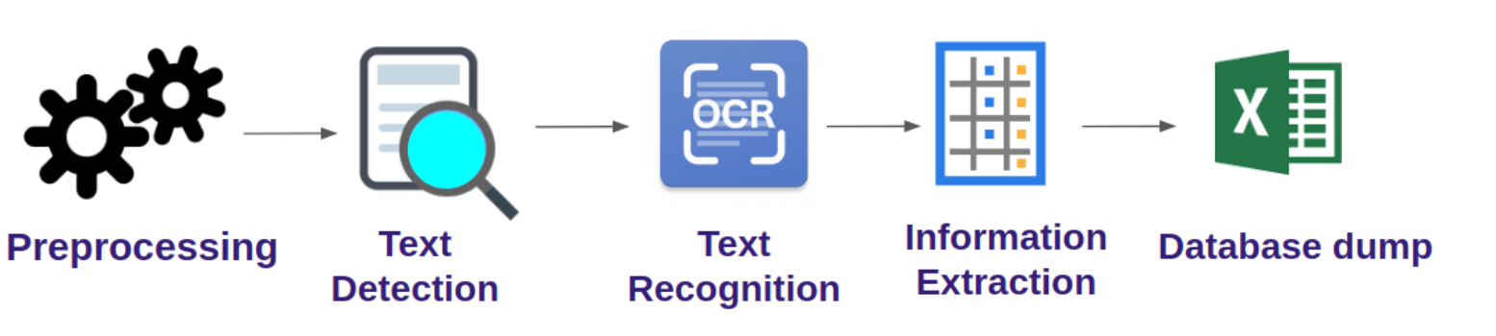
How the reimbursement process of Lisa will be validated at backend once he has uploaded his bills and credentials for Reimbursement at SecureClaim Portal?
A Traditional Receipt Digitization Pipeline
A typical pipeline for this kind of an end-to-end approach involves:
Preprocessing
Optical Character Recognition
Information Extraction
Data dump

Slide 3
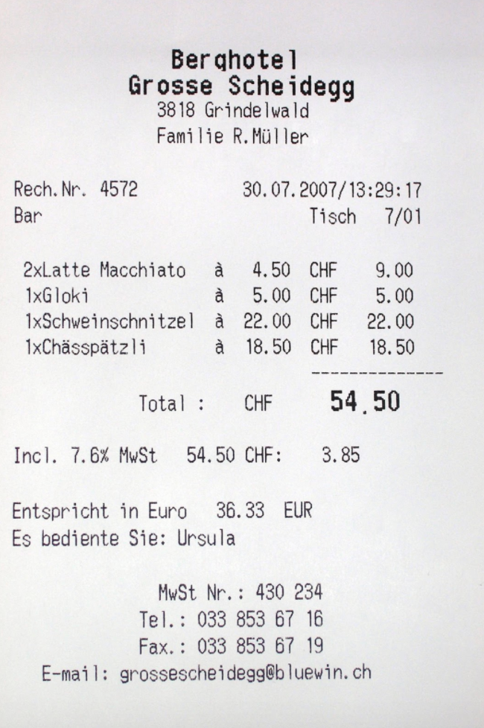
IMAGE PREPROCESSING
The receipt is First converted to grayscale after which we apply thresholding to the image by applying a threshold of 210. We have used OPENCV for the same.
OCR-TEXT DETECTION AND TEXT RECONGNITION USING TESSAREACT
For Text Detection and Text Recongniton we are using open source library called tessaract-We will Tesseract to perform OCR. Tesseract 4 uses a deep learning approach that performs significantly better than most other open-source implementations.
INFORMATION EXTRACTION FOR VALIDATION OF AMOUNT ENTERED USING NER(Named Entity Recongnition)
As mentioned before the most common way of extracting information is by a rule-based approach.
All receipts from this hotel will follow a fixed structure and the information appears on different lines.

Slide 4
TF-IDF VECTORIZATION
TF-IDF (Term Frequency-Inverse Document Frequency) is a technique used in natural language processing to convert text data into numerical vectors, representing the importance of each word in a document relative to a collection of documents, helping to capture the unique features of each document for various machine learning tasks like text classification and information retrieval.
PASSED AS INPUT TO THE MODEL- LOGISTIC REGRESSION(Tried Models-XGBOOST, RANDOM FOREST , NAÏVE BAYES, Multinomialnb, SVM (SUPPORT VECTOR MACHINE) ) AND DESIRED STATUS IS UPDATED IN DATABASE
This TF-IDF Vectorised text is given as input to the prediction function which in turn is given as input to our model which in turn update the prediction result in the status column of database

Slide 5

Thank You!
Any Questions…?

